Slide 1
Autonomous Disaster Response Coordination System
Batch-04
Batch Name – Agent Verse
P. Mohana Srija-241FA04331
A. Sai Likhitha-241FA04334
P.Harshitha-241FA04313

Slide 2
Introduction:
Overview: The Autonomous Disaster Response Coordination System is a web-based platform that uses Artificial Intelligence to manage disaster emergencies in real time. It automates the entire response pipeline — from receiving a disaster report to dispatching resources and alerting the public.
Current Challenges:
Emergency teams lack real-time data on disaster severity
Resources (ambulances, rescue teams) are allocated manually without optimization
Citizens have no easy way to send SOS or receive emergency broadcasts
Language barriers prevent effective communication in regional areas

Slide 3
What Problem Does This Project Solve?
When a disaster occurs, three critical questions must be answered immediately:
How severe is it? — No automated severity assessment exists
What resources should be sent? — Manual allocation wastes time and resources
How do we alert people? — No unified alert + communication system

Slide 4
Methodology:
Steps Followed:
1. Requirement Analysis — Identified key disaster response workflows
2. System Design — Designed MongoDB schema, Flask blueprints, and agent pipeline
3. Backend Development — Built 4 AI agents + 13 route modules in Python/Flask
4. Frontend Development — Responsive UI using Bootstrap 5, Leaflet.js maps
5. Integration — Connected Groq API (Llama 3), OpenWeatherMap API, WhatsApp (Twilio)
6. Security — Implemented password hashing + OTP-based 2FA7. Testing & Seeding — Used seed_db.py to populate sample data

Slide 5

Tools & Technologies:
Programming Languages:
Python 3.12 (Backend)
HTML5, CSS, JavaScript (Frontend)

Slide 6
Frameworks & Libraries:
Category | Technology | Purpose
Web Framework | Flask 3.0.3 | Backend routing and templates
Auth | Flask-Login 0.6.3 | Session management
Security | Werkzeug 3.0.3 | Password hashing
AI / LLM | Groq API + Llama 3 | Disaster analysis, chatbot
OTP | pyotp 2.9.0 | 6-digit 2FA codes
HTTP | requests 2.34.2 | Weather API calls
Messaging | Twilio 9.10.9 | WhatsApp alerts
UI | Bootstrap 5.3.2 | Responsive design
Maps | Leaflet.js 1.9.4 | Interactive incident maps
Charts | Chart.js 4.4.2 | Analytics dashboard
PDF | jsPDF 2.5.1 | Report downloads
Markdown | marked.js 9.1.6 | Chatbot formatting
Voice | Web Speech API | STT + TTS in chatbot

Slide 7
Database: MongoDB (PyMongo 4.7.3)
External APIs:
Groq API (Llama 3 8B) — AI intelligence
OpenWeatherMap API — Live weather
Nominatim (OpenStreetMap) — Geocoding
Gmail SMTP — OTP email delivery
Twilio WhatsApp — Mass alerts
Tools: VS Code, MongoDB Compass, Git, Python pip

Slide 8
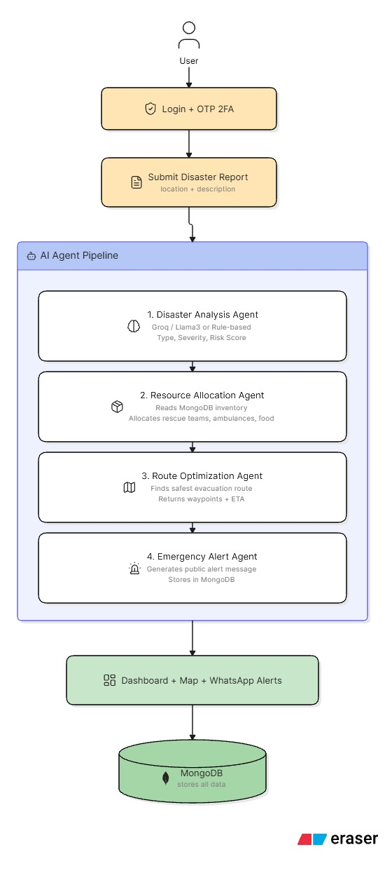
System Architecture

Slide 9
How the System Works:
User registers and logs in with OTP 2FA (email)
Submits a disaster report with location and description
All 4 AI agents fire automatically in sequence
Results shown on screen + stored in MongoDB
WhatsApp alerts sent to all registered users
Dashboard updates in real time

Slide 10
Features
Feature | Description
🔐 Secure Login | Username + password + 6-digit OTP via Gmail
🤖 4 AI Agents | Analysis → Allocation → Route → Alert pipeline
🗺️ Live Map | Leaflet.js map with all disaster incidents and SOS pins
🆘 SOS Alerts | One-click emergency alert with WhatsApp notification
🌤️ Weather Monitor | Live weather + 7-day forecast + disaster risk assessment
🤖 ARIA Chatbot | AI assistant in English and Telugu with voice support
📊 Analytics | Charts for severity, disaster types, resource usage
🙋 Volunteers | Register, manage skills, deploy to disaster sites
📢 Broadcast | Mass notifications with WhatsApp delivery
📄 PDF Reports | Download disaster analysis reports as PDF
🔊 SOS Sound | Emergency siren plays on SOS submission

Slide 11
User Benefits:
Citizens can report disasters and send SOS from any device
Coordinators get instant AI analysis without manual assessment
Resources are allocated automatically — no spreadsheets needed
Everyone receives WhatsApp alerts without installing any app
Special Features:
ARIA — speaks and understands both English and Telugu
Voice-to-Voice — speak a question, hear the answer
Offline fallback — rule-based AI works even without Groq API key
Real-time badge — SOS count updates every 20 seconds in the navbar

Slide 12
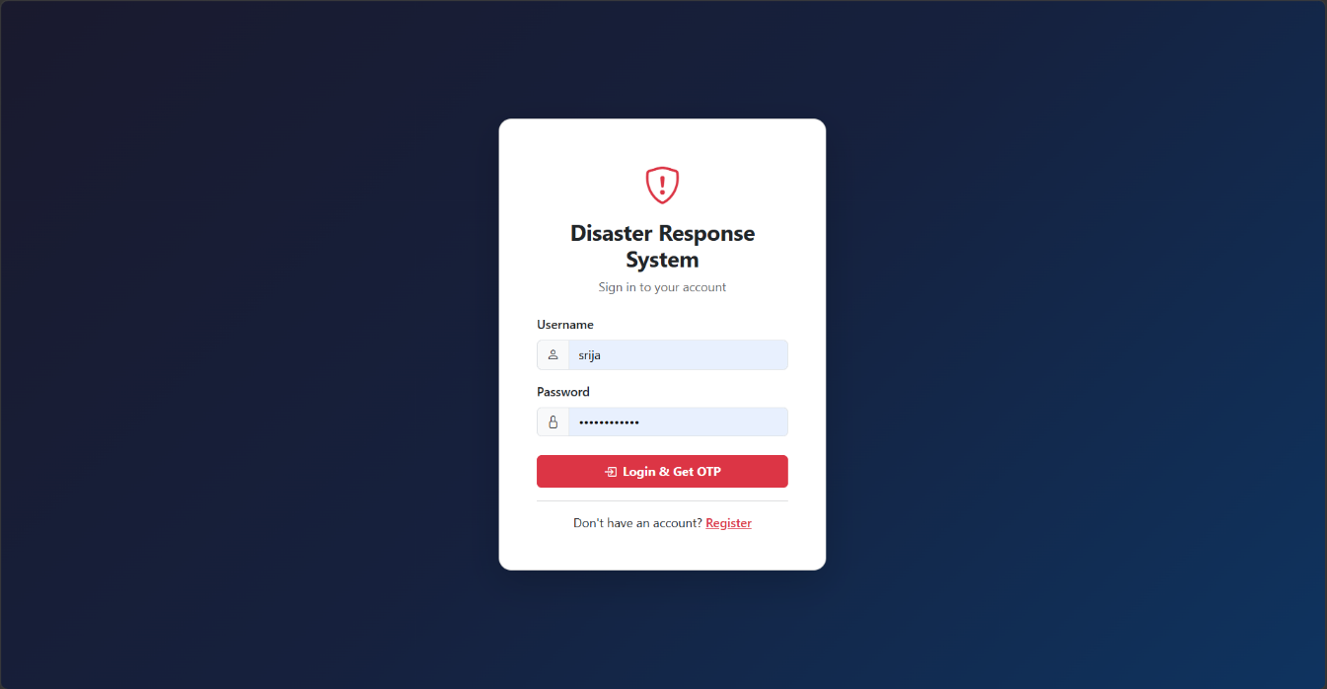
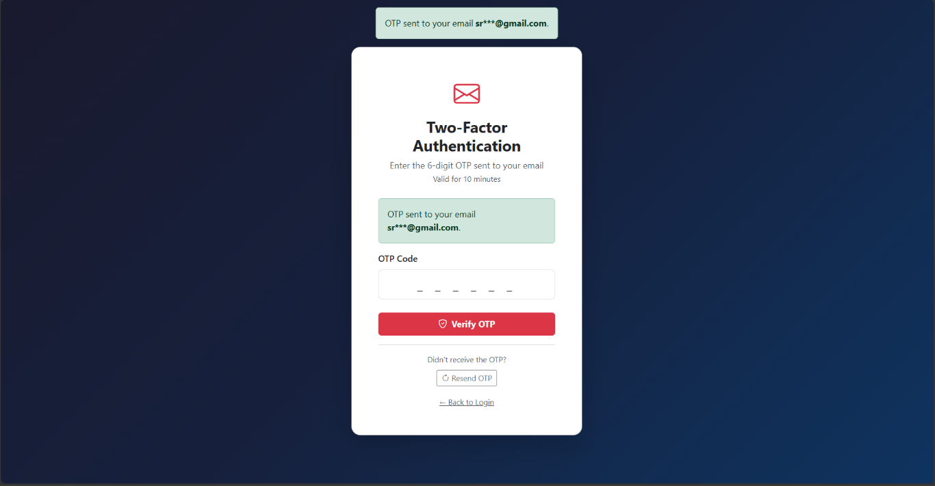
Outputs:

Slide 13
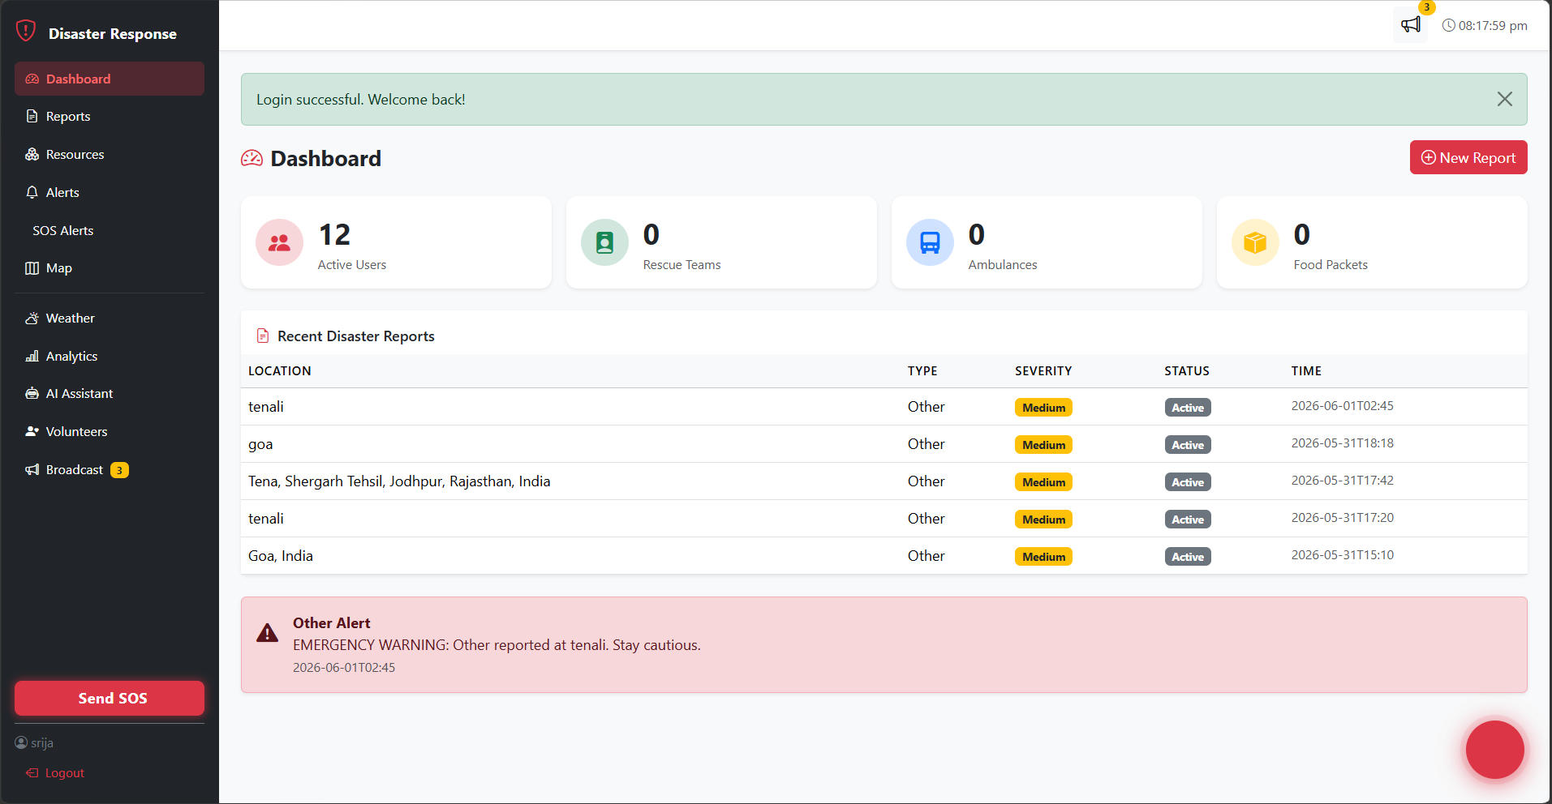
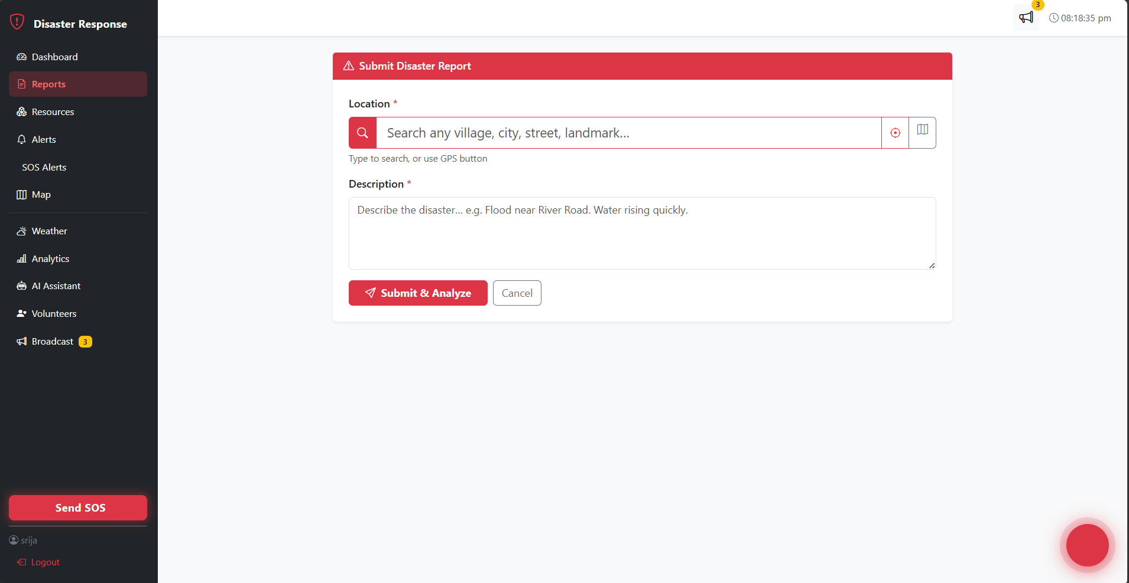

Slide 14
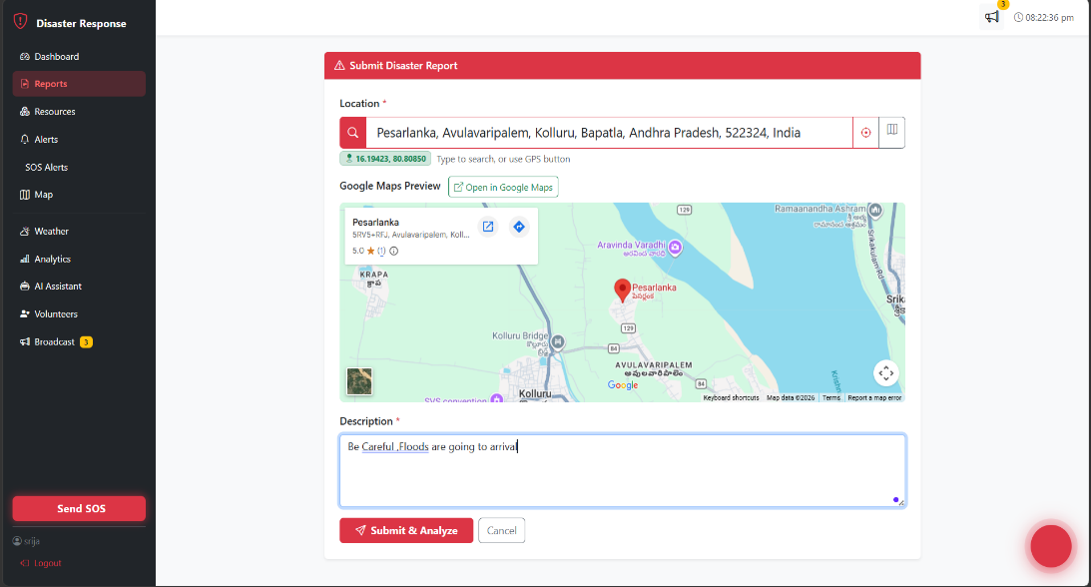
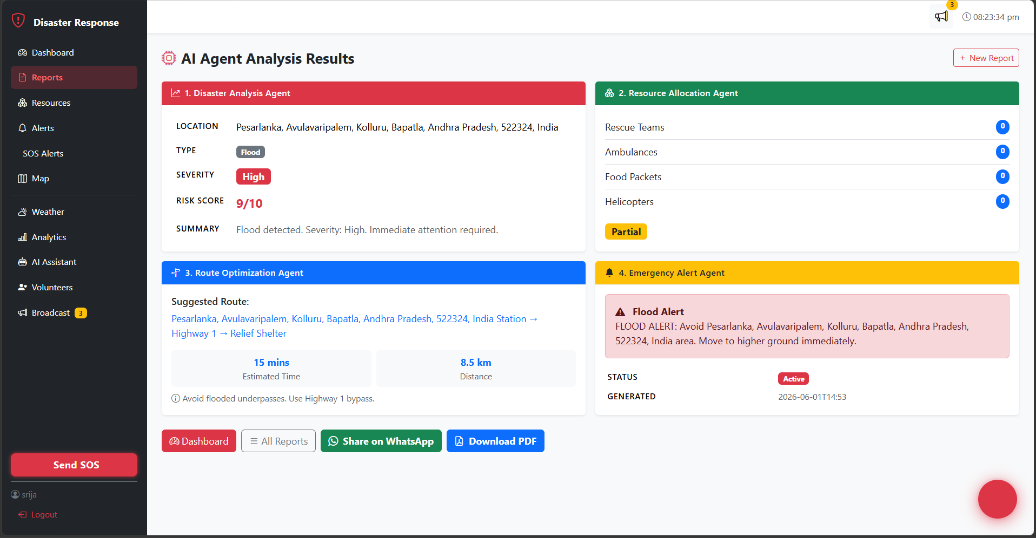

Slide 15
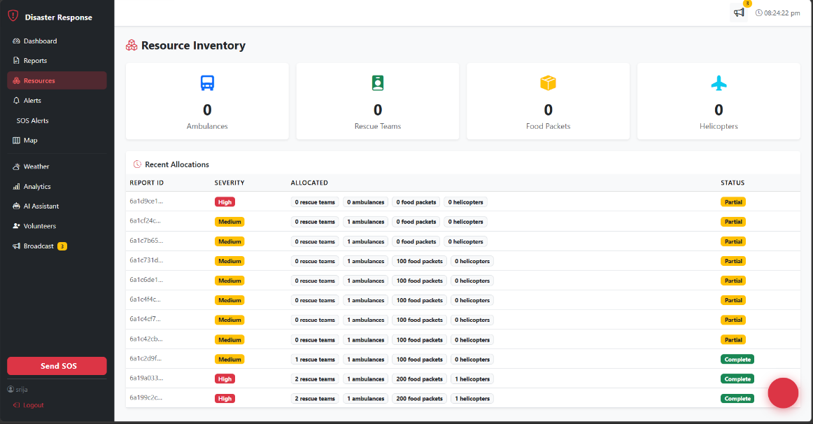
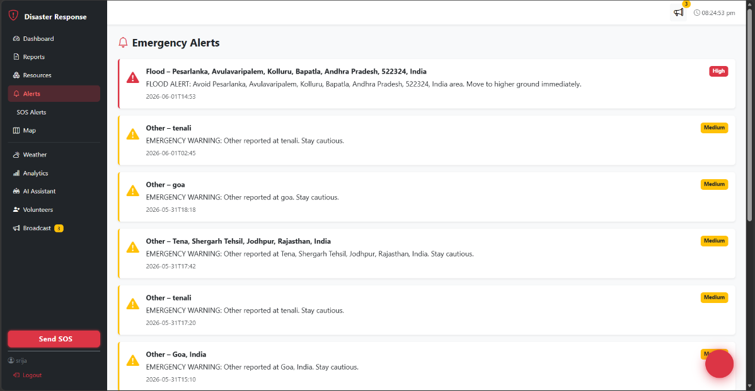
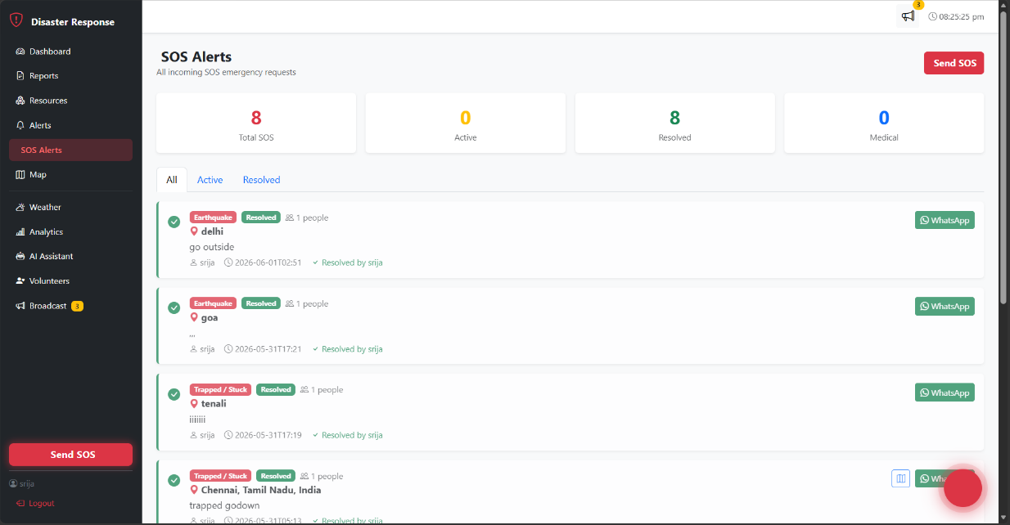
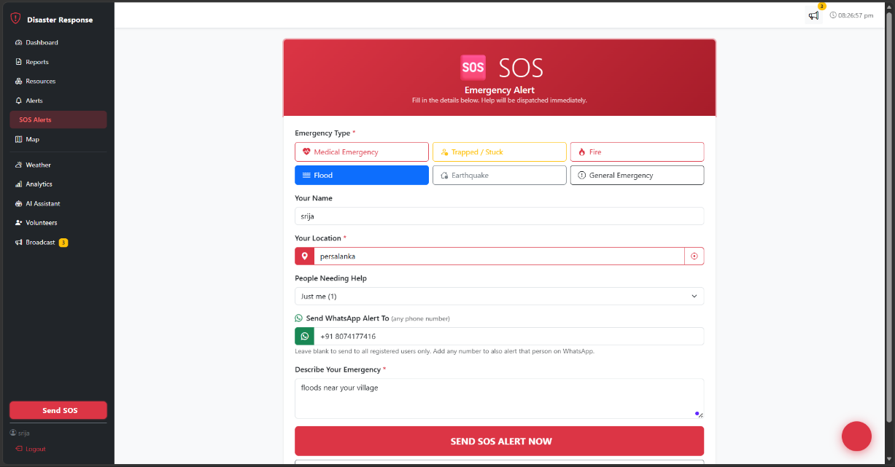

Slide 16
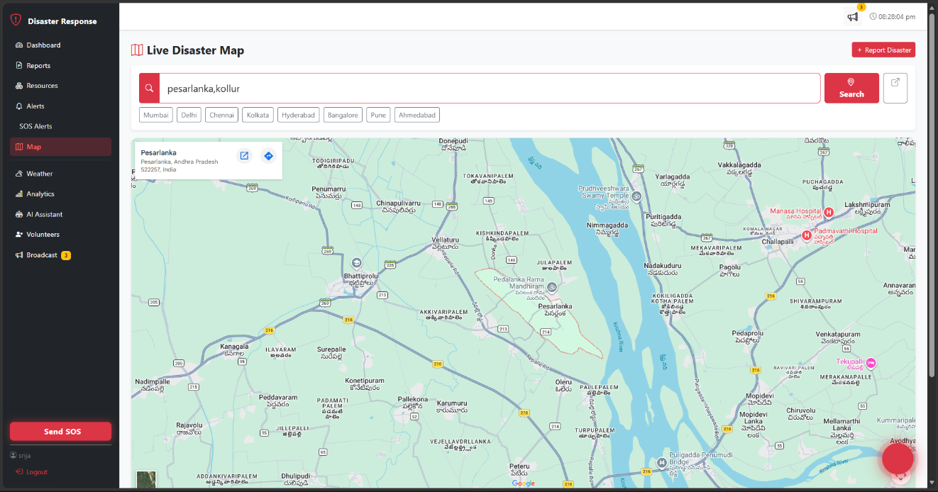
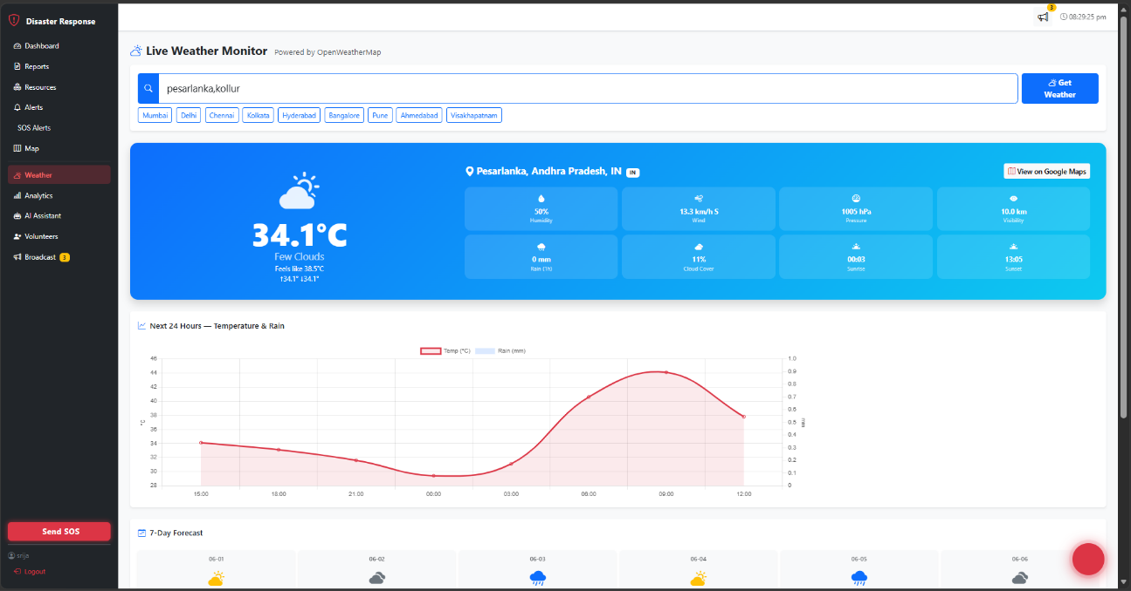
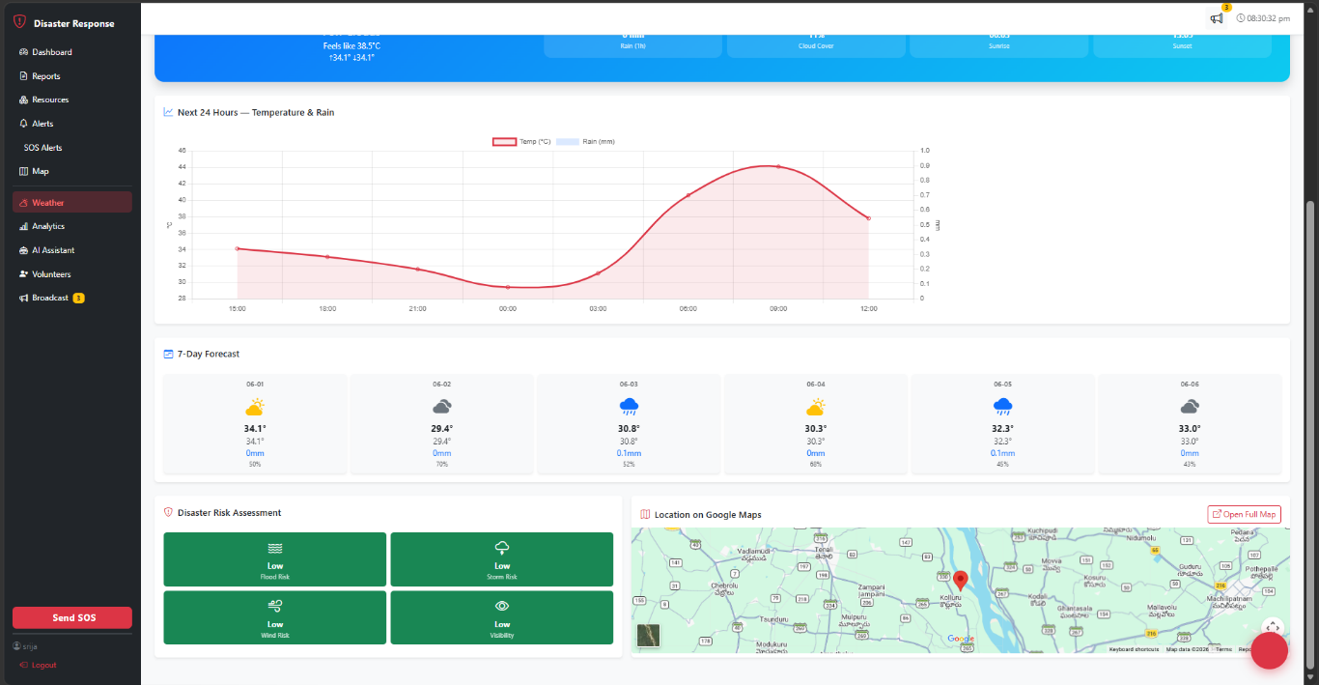
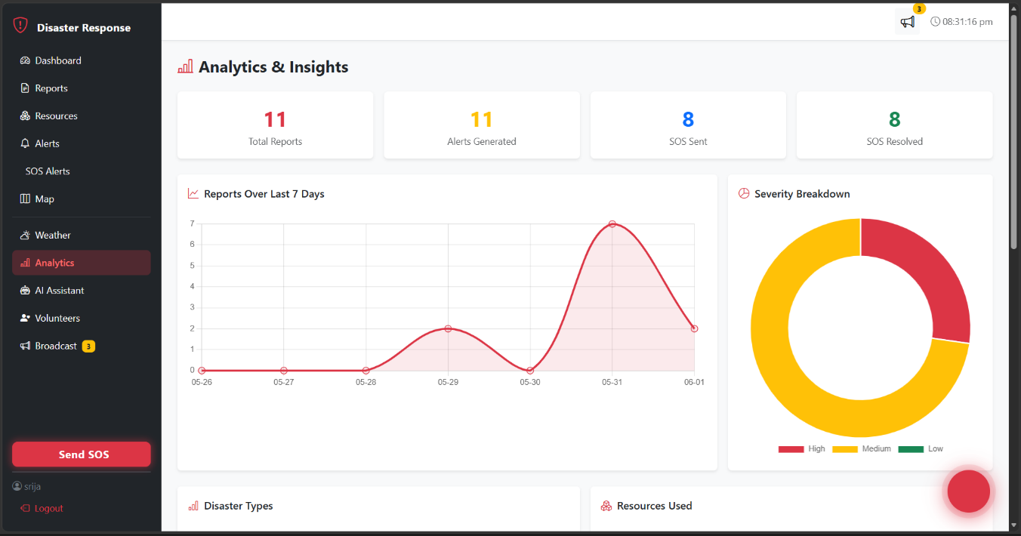

Slide 17
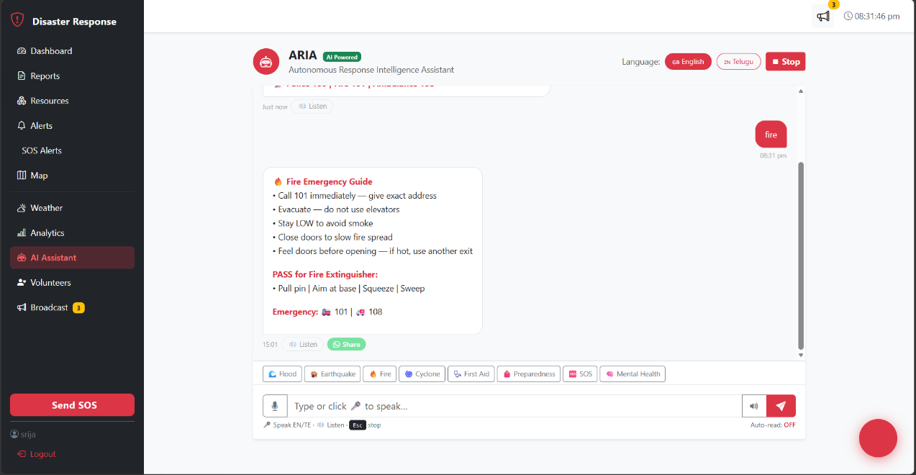
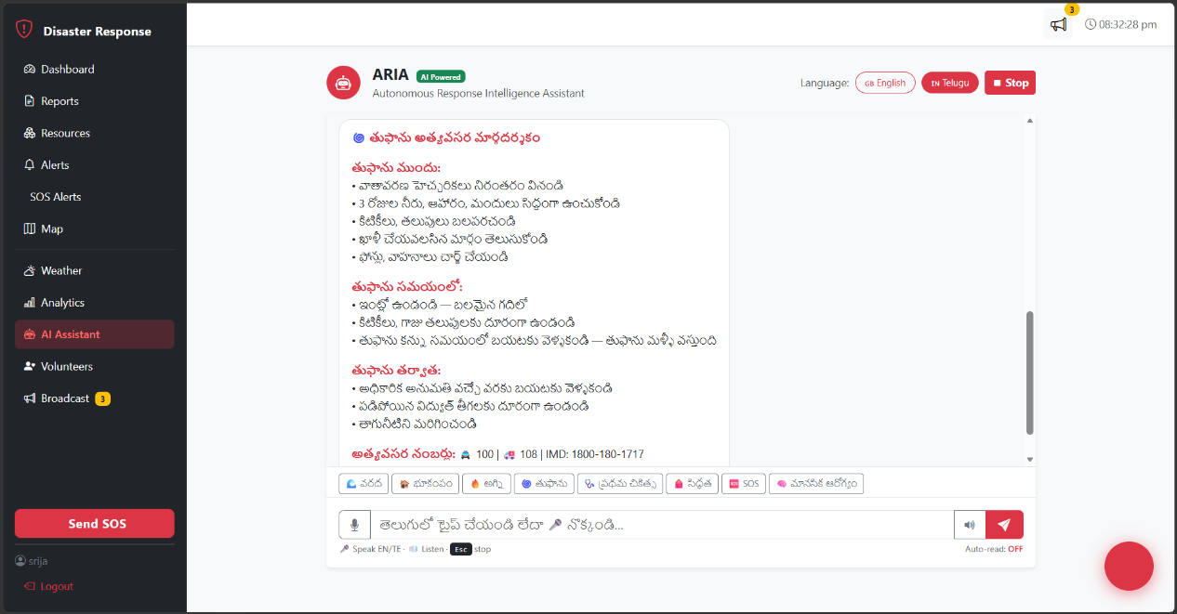
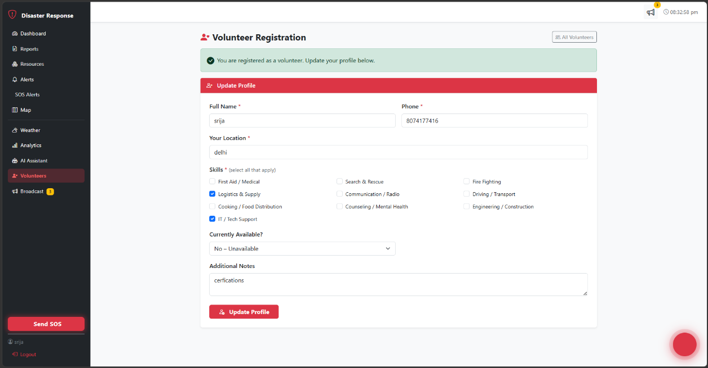
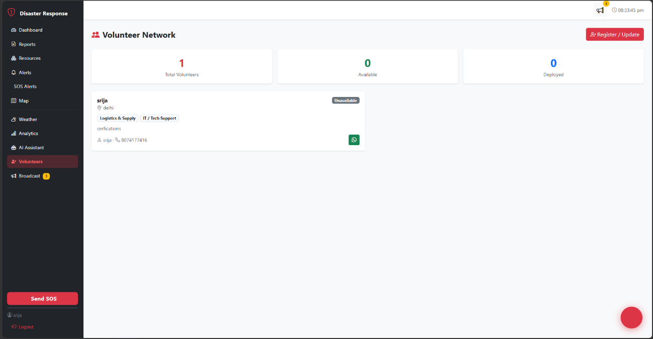

Slide 18
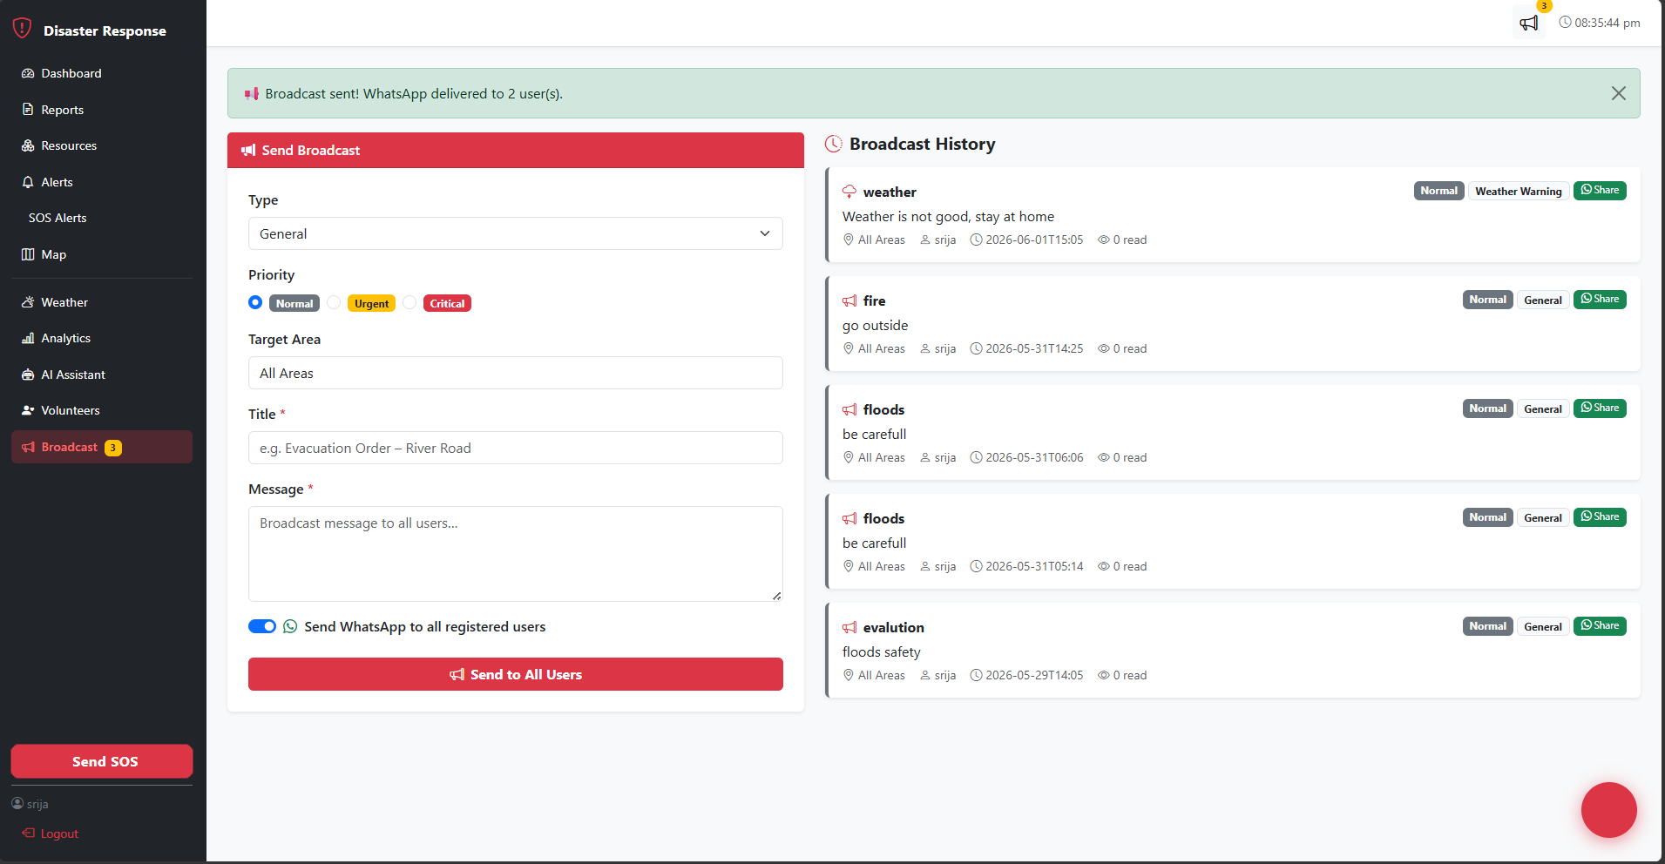
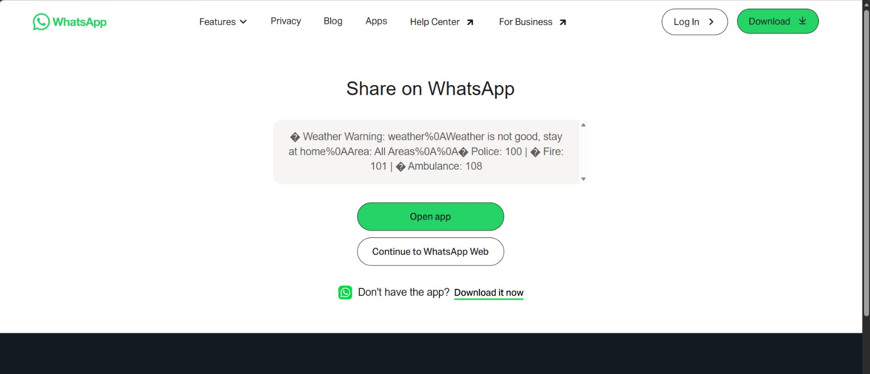

Slide 19
Conclusion:
Summary of Key Points:
Built a full-stack disaster response platform with Python/Flask and MongoDB- Integrated 4 autonomous AI agents that work in a pipeline: analyze → allocate → route → alert
Added real-world communication channels: WhatsApp SOS, mass broadcasts, weather warnings
Delivered a bilingual AI chatbot (ARIA) with emergency guidance in English and Telugu
Secured the system with OTP-based two-factor authentication

Slide 20
References:
Flask Documentation — https://flask.palletsprojects.com/en/3.0.x/
MongoDB PyMongo Documentation — https://pymongo.readthedocs.io/en/stable/
Groq API Documentation — https://console.groq.com/docs/openai
Meta Llama 3 Model — https://llama.meta.com/llama3/
OpenWeatherMap API — https://openweathermap.org/api/one-call-3
Leaflet.js Documentation — https://leafletjs.com/reference.html
Bootstrap 5 Documentation — https://getbootstrap.com/docs/5.3/
Twilio WhatsApp API — https://www.twilio.com/docs/whatsapp
pyotp Library — https://pyauth.github.io/pyotp/
Chart.js Documentation — https://www.chartjs.org/docs/latest/
jsPDF Documentation — https://artskydj.github.io/jsPDF/docs/
Web Speech API — https://developer.mozilla.org/en-US/docs/Web/API/Web_Speech_API
NDRF India — https://ndrf.gov.in
National Disaster Management Authority — https://ndma.gov.in
Git Hub Link:
https://github.com/purammohanasrija-arch/Autonomous-Disaster-Response-Coordination-System

Slide 21
THANK YOU

